Slide 1
Need Finding
Emmanuel Respicio
Jhed Ross Bunagan

Slide 2
Observation

Slide 3
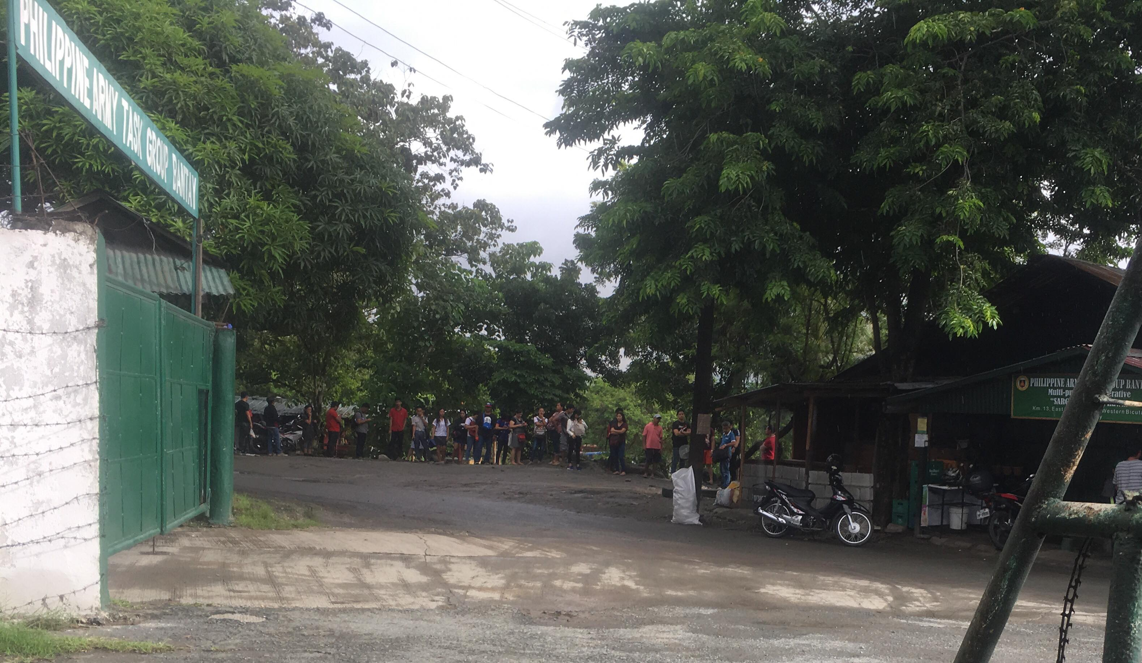
The researcher decided to observe the terminal in the service road (route FTI to Moa vice versa). Also, on how does the people got a ride on time.
Commuters does not have any assurance when they can have a ride.
The jeepney driver need to have a high offer for them to “pasada”
High offer to jeepney driver can make more jeepney in the terminal.

Slide 4
User Needs

Slide 5
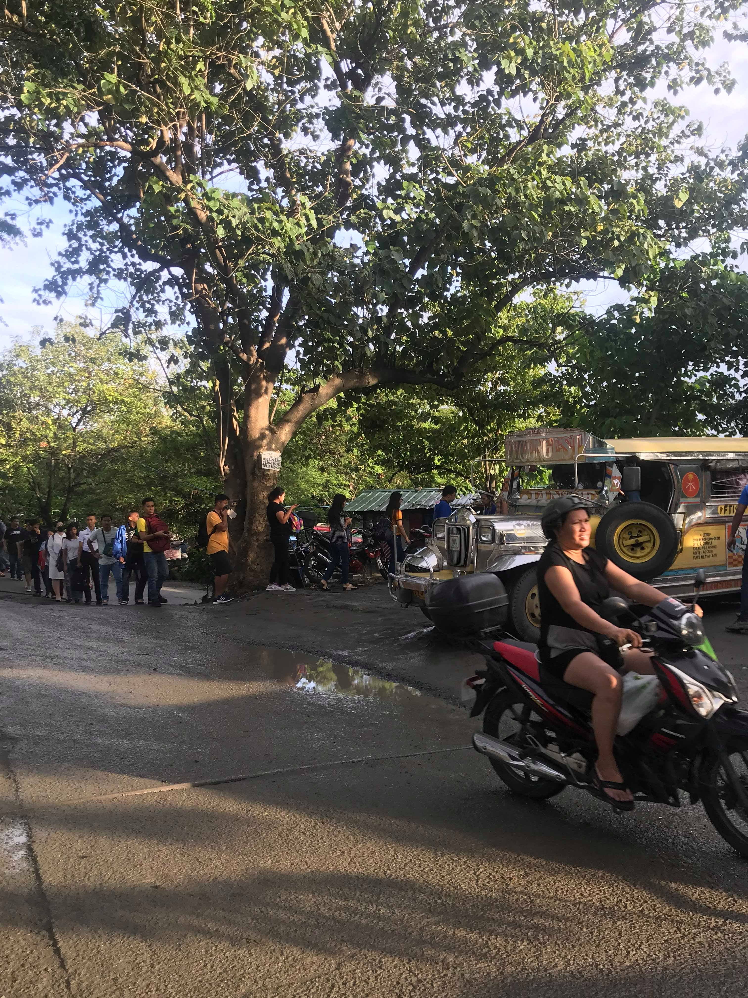
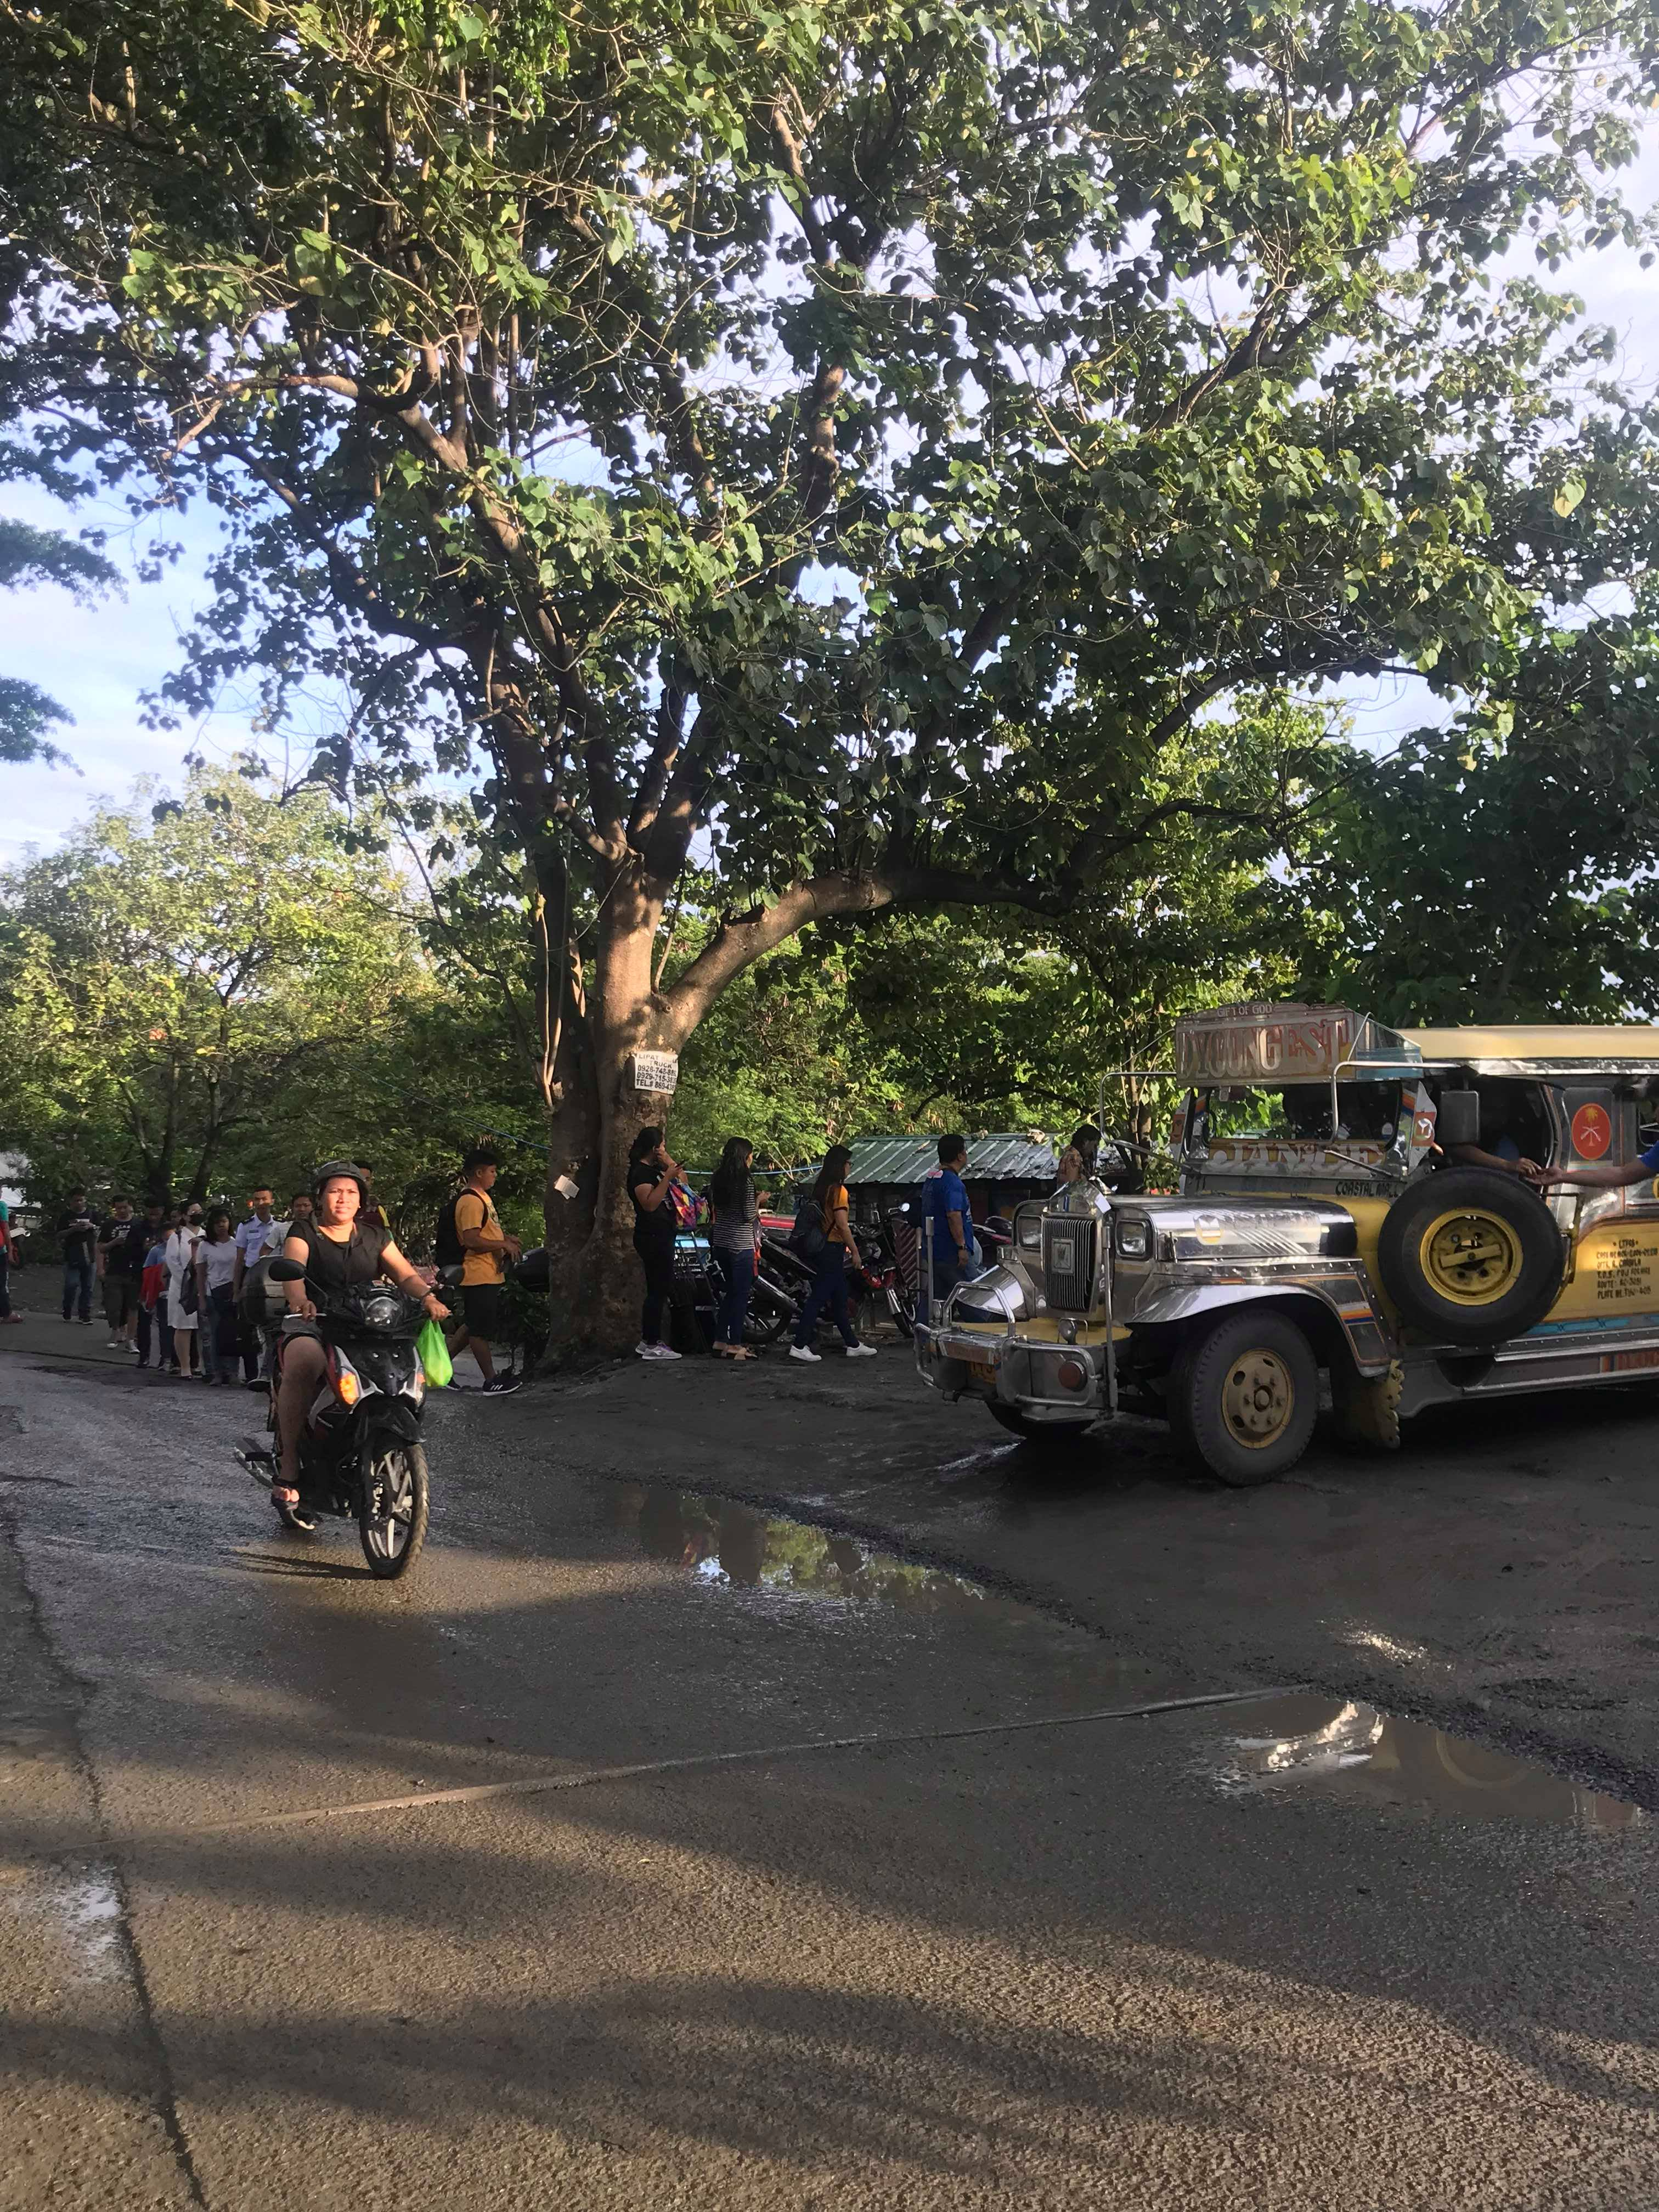
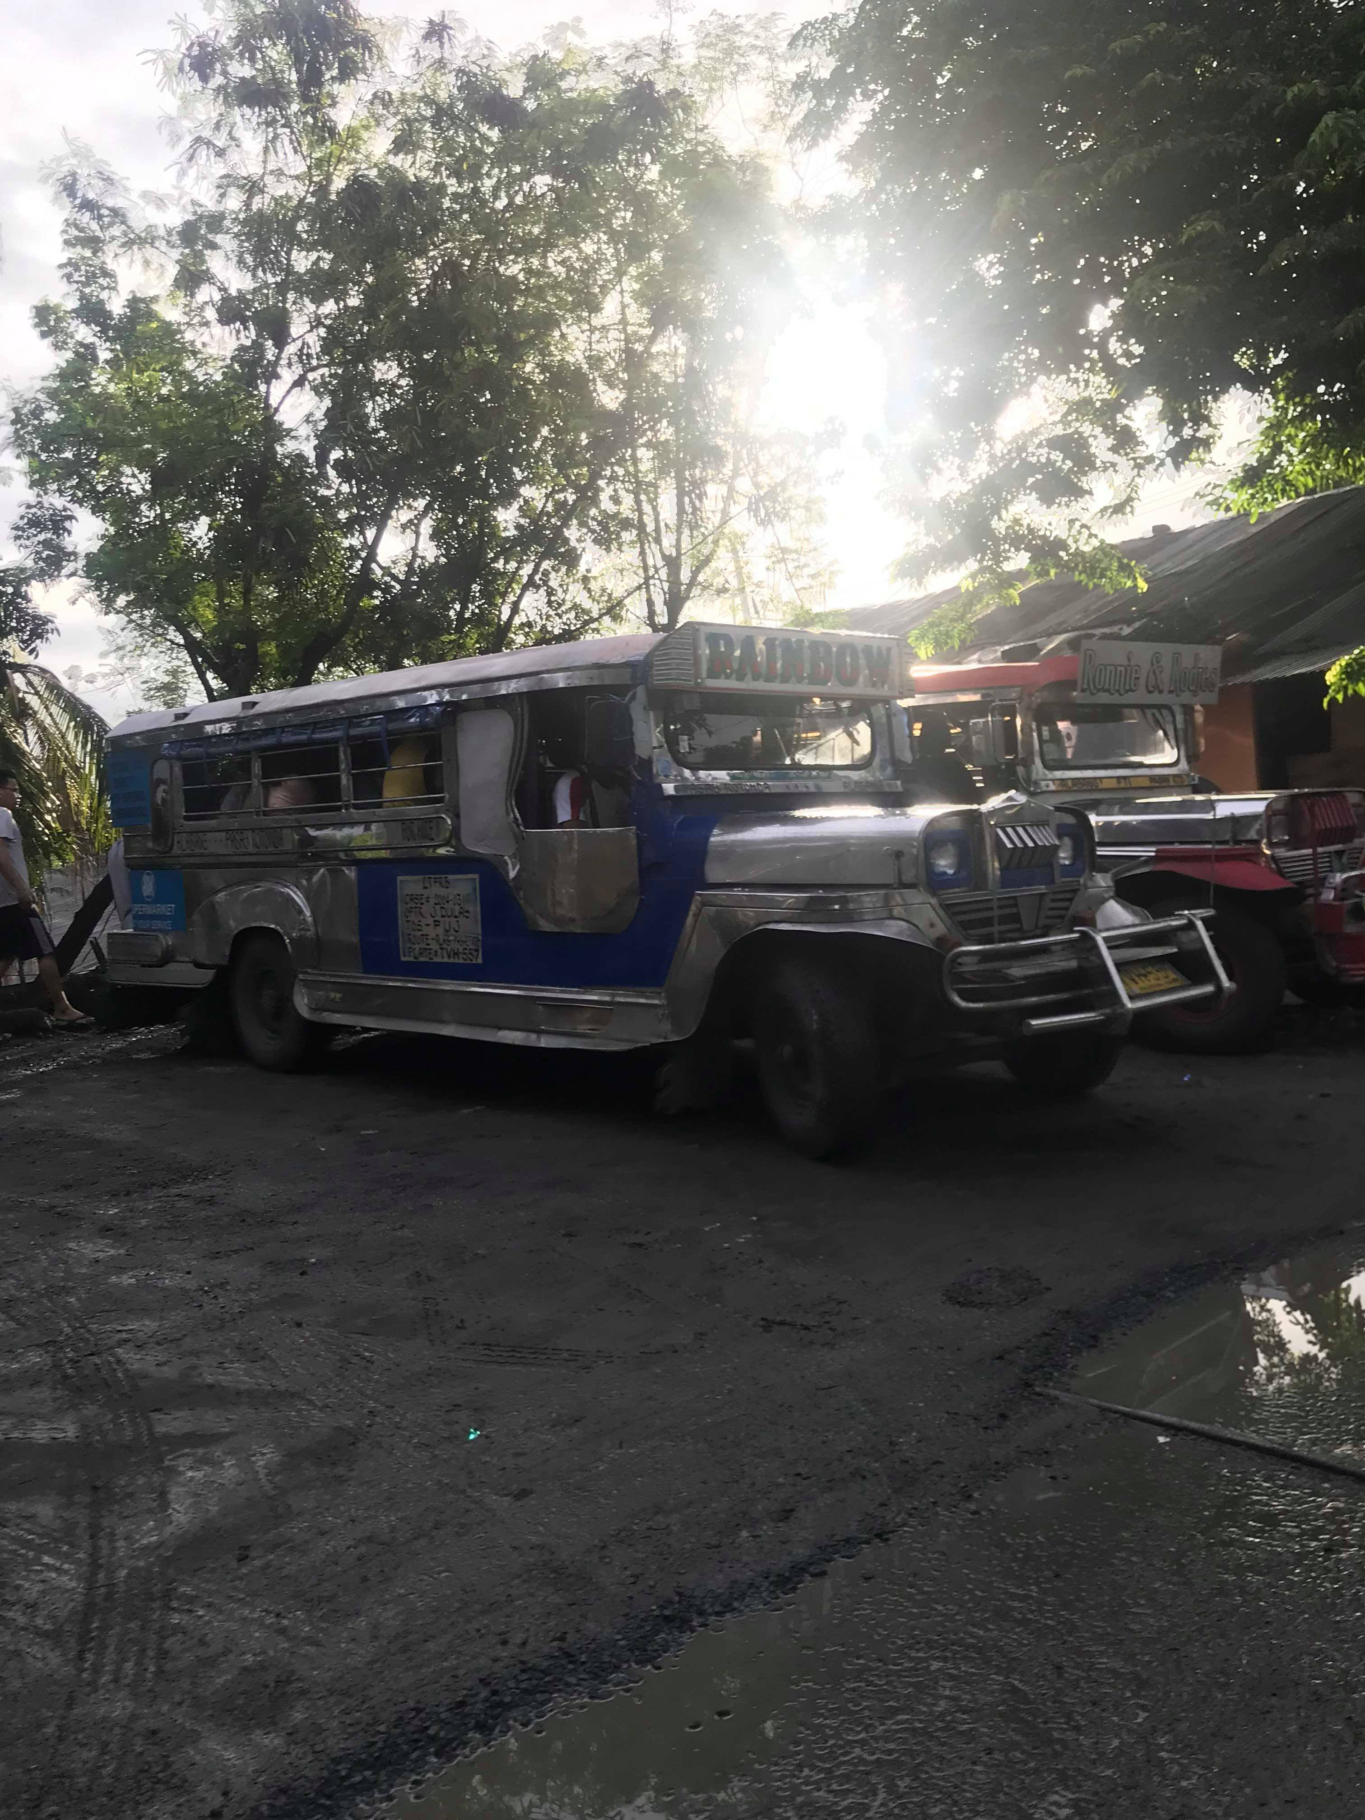
They need to have assurance in what time they can get a ride.
Commuters need to get an efficient ride.
Jeepney commuter need to get a ride with a short period of time. So that they can manage their time as well.

Slide 6
Point of View

Slide 7
Jeepney app for reservation of slot. (Grab jeep)
An application for a jeepney driver for them to have a high incentive when they “pasada” with in the app.
The user would like to know whats the route of that jeep.

Slide 8
User Point of View

Slide 9
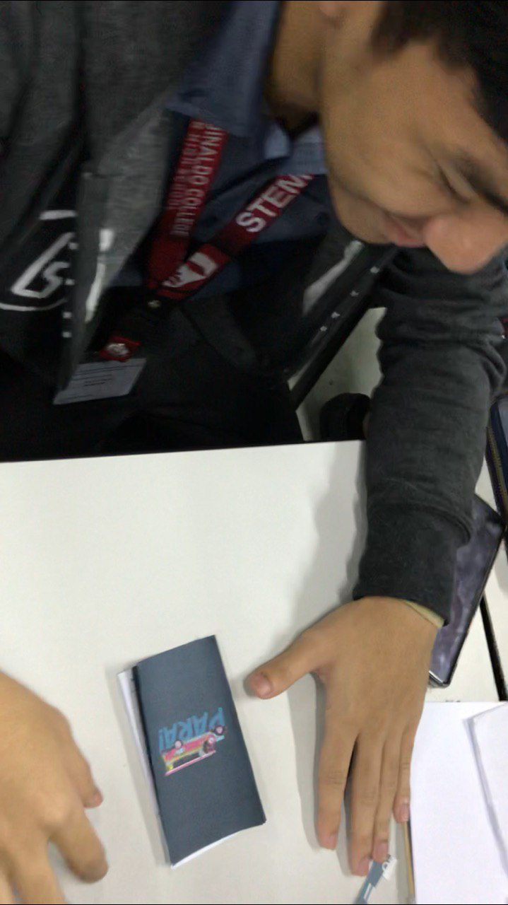
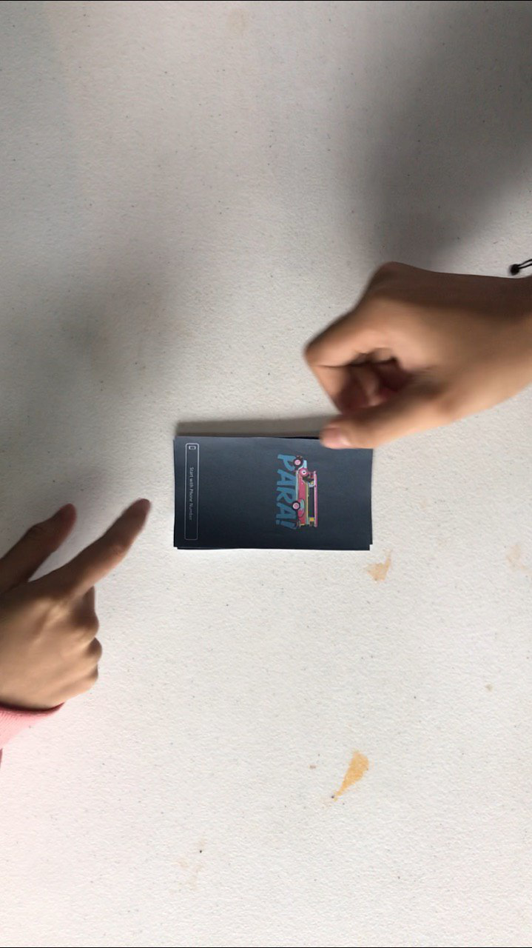
User 1
Its okay since it brings convenience especially to the commuters that is rushing.
I would like to recommend in the “next” button should be in the bottom right corner for the easy access.
Over all, the app is good for the convinces to the commuters as well as the drivers.
“

Slide 10
User 2
Application bought me an easy way to commute in my way going to school.
“

Slide 11
User 3
Its a beautiful interface app. But how about the people who can’t have an Internet, a smartphone its kind of unfair. Also, the cost fair it’s too high for the commuters who will drop near. Which it’s a fixed rate.(P20.00)
“

Slide 12
Driver 1
The app is okay since its original and this app would be first. However, it cannot do in a normal routes because its kind of point-to-point jeep. Which people are used to pila-sakay-baba-pila-sakay-baba.)
“

Slide 13
Driver 2
For me the app is okay. But I would like it more when more screen to show. However, over all the app is good. All buttons are working.
“

Slide 14
Driver 3
This app brings convenience to us driver and the for commuters. As it need to have a dry run to know if it’s effective.
“

Slide 15
Revised Paper Prototype

Slide 16
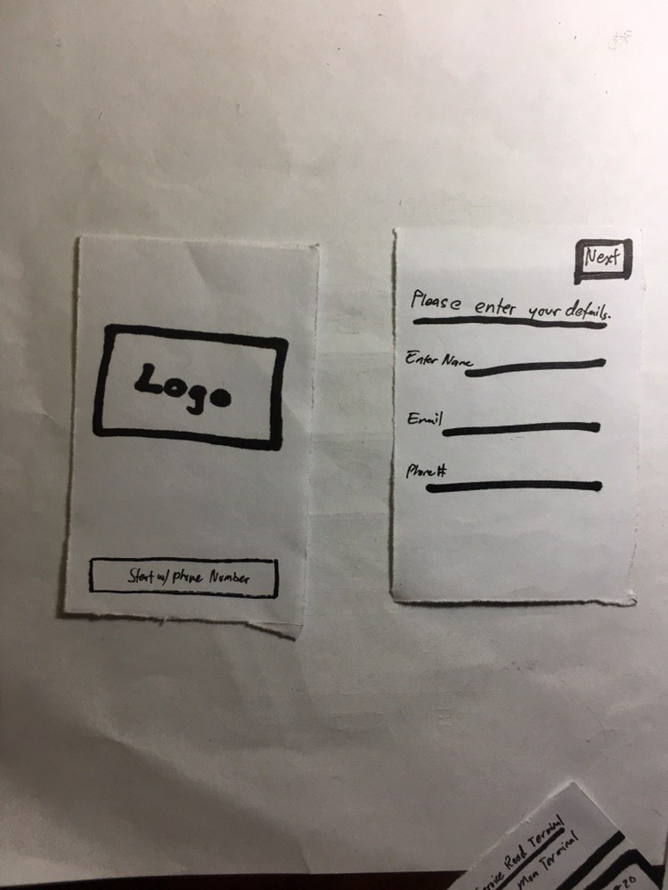
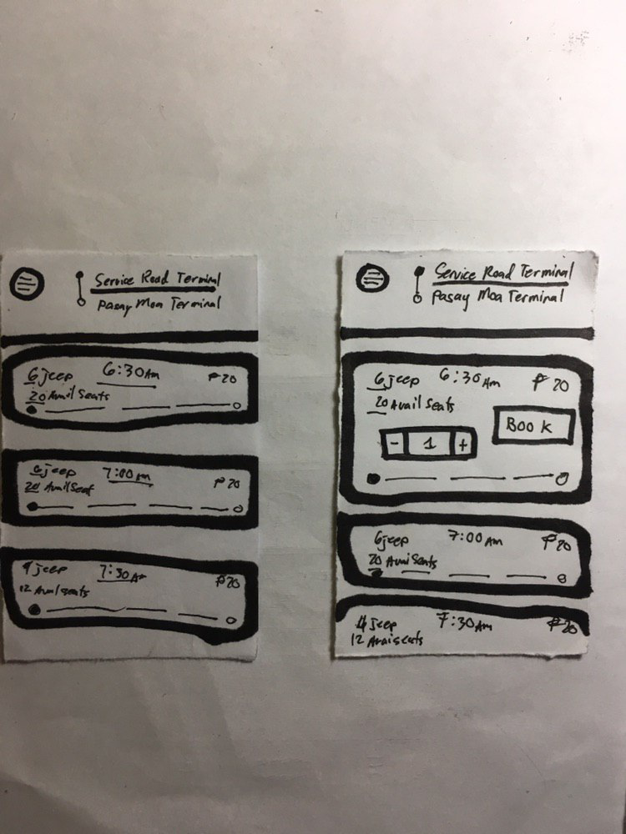
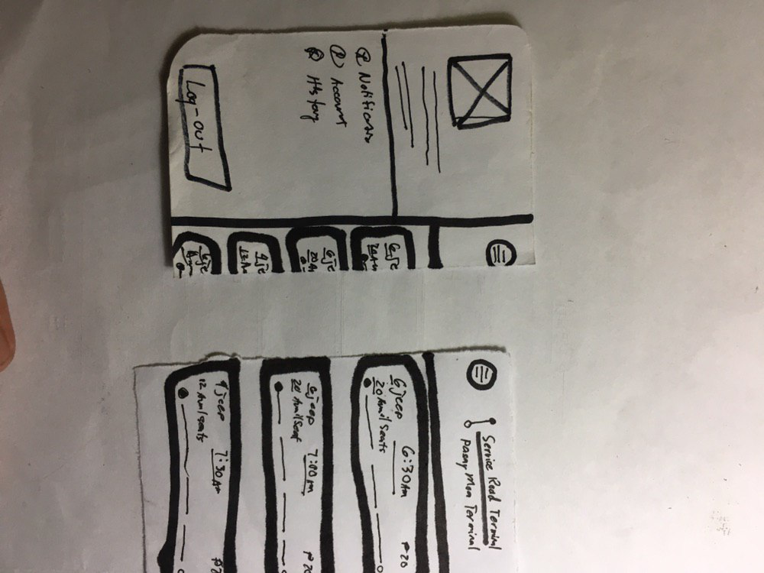
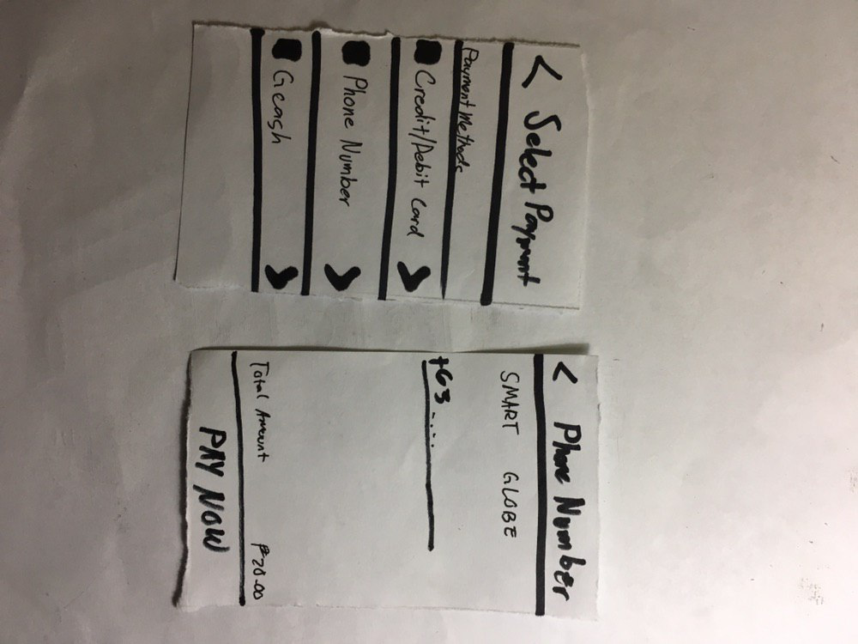
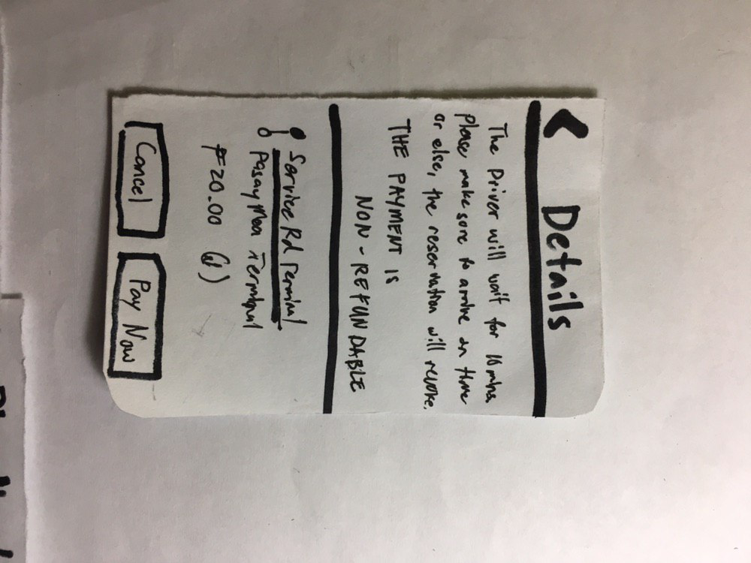

Slide 17
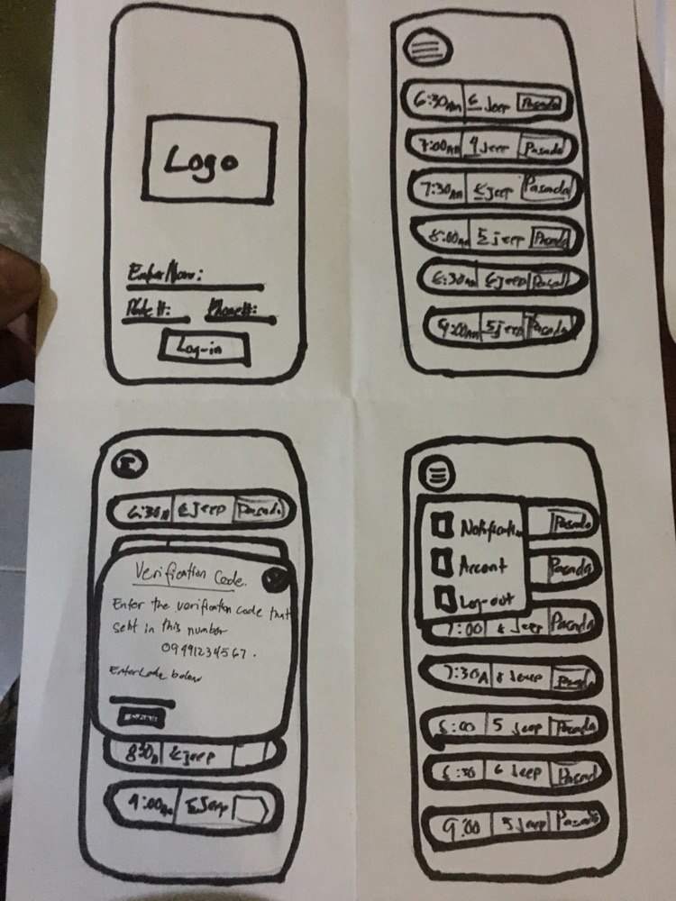

Slide 18

Place your screenshot here
Mockup
Notes:
Driver
https://emmanuelrespicio133590.invisionapp.com/overview/Para-ck0ezbtra0hy30185qkqgg84b/screens?v=ydeHOqMISFTZ%2FtAEK5%2Fz%2Fw%3D%3D&linkshare=urlcopied
Passenger
https://emmanuelrespicio133590.invisionapp.com/overview/Para2-ck0ezp1mb0amb017nf61o8bt8/screens?v=ydeHOqMISFTZ%2FtAEK5%2Fz%2Fw%3D%3D&linkshare=urlcopied

Slide 19

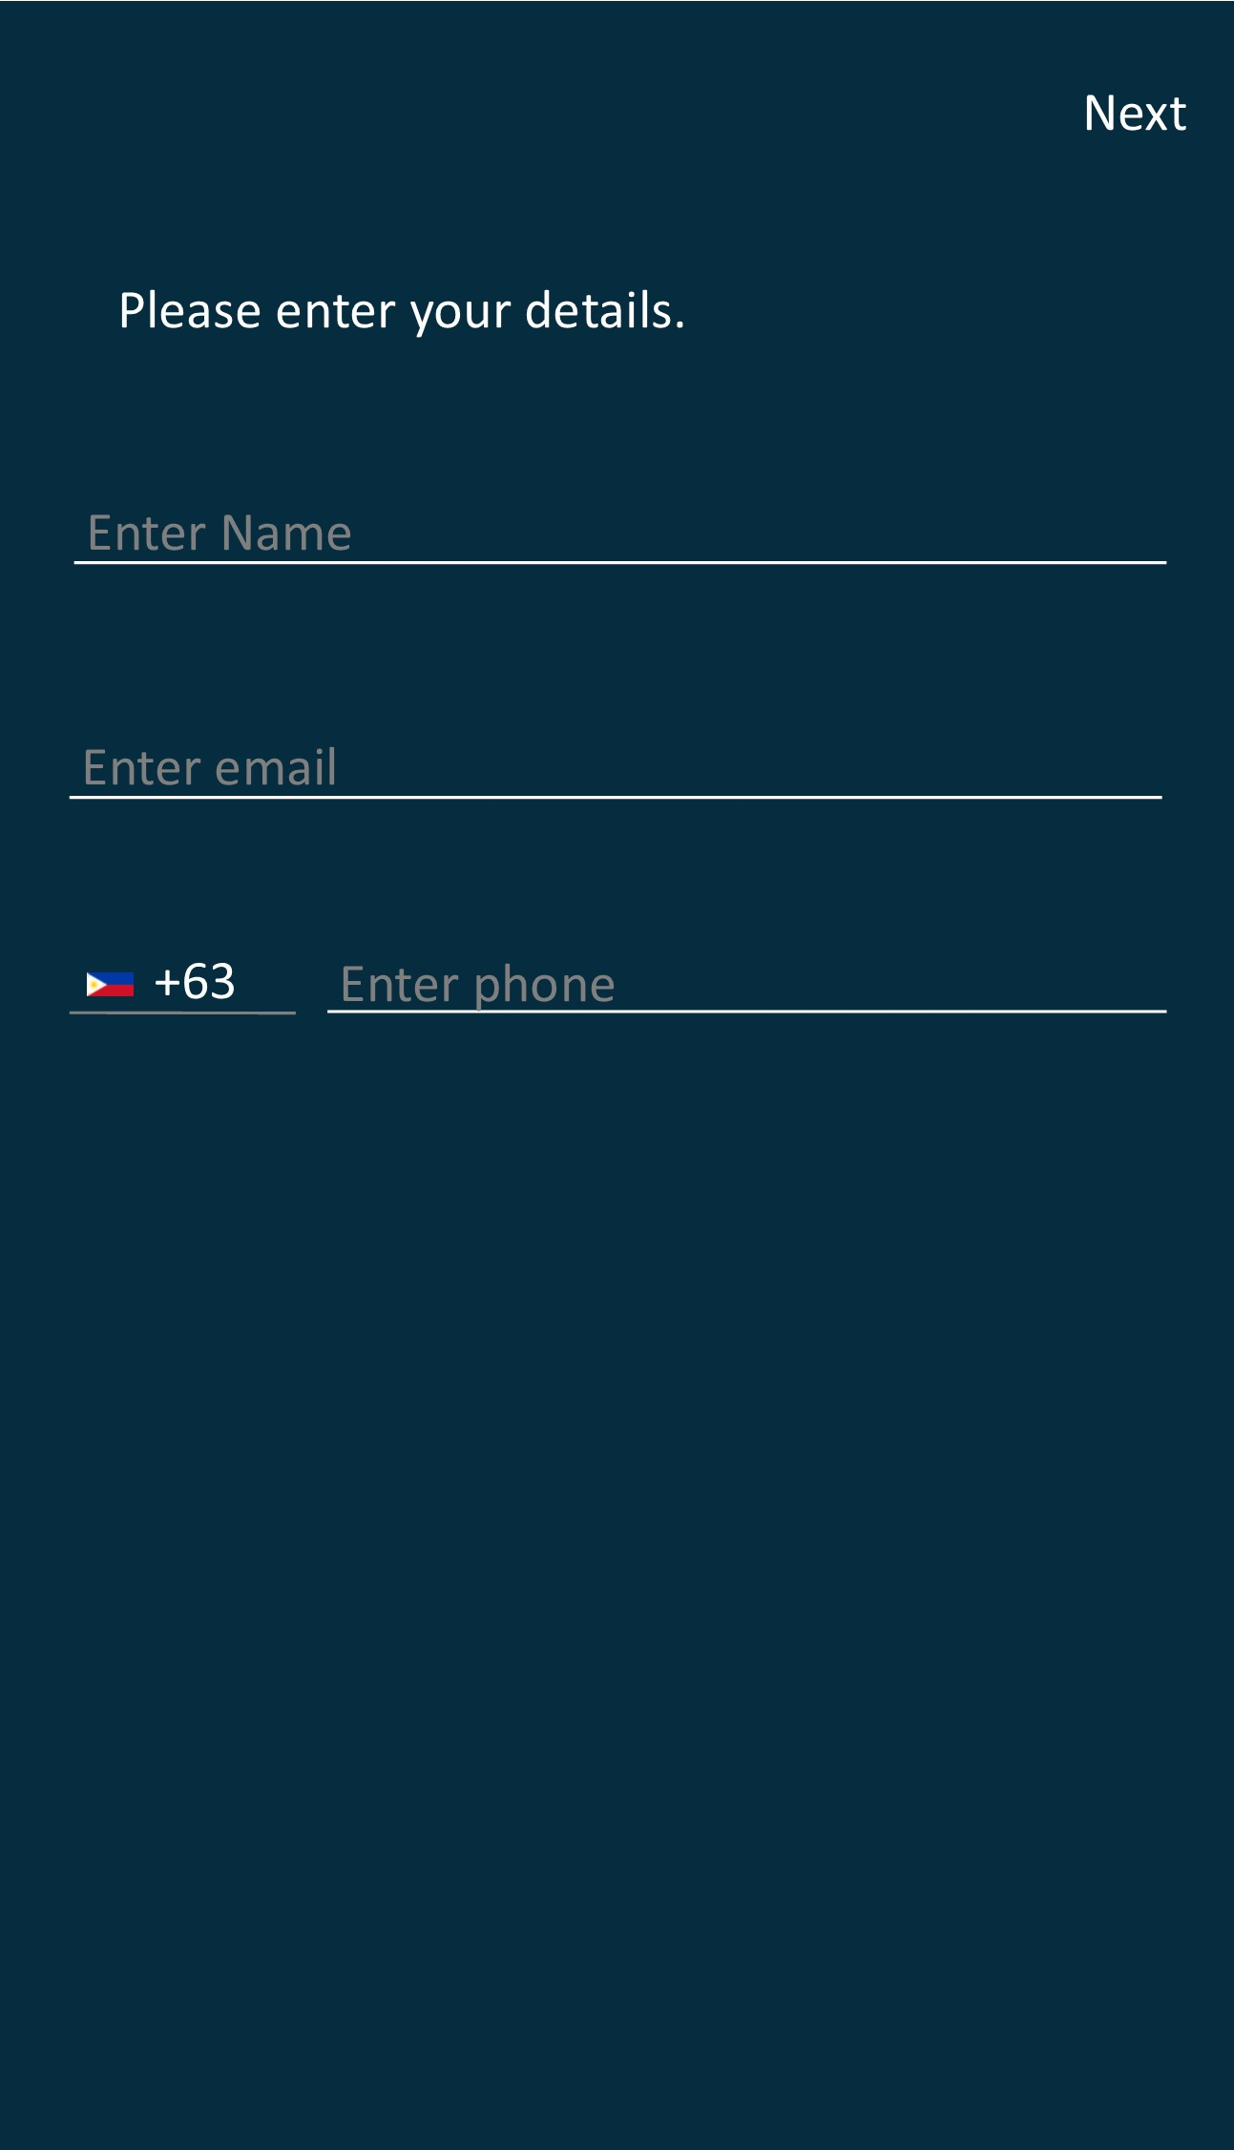
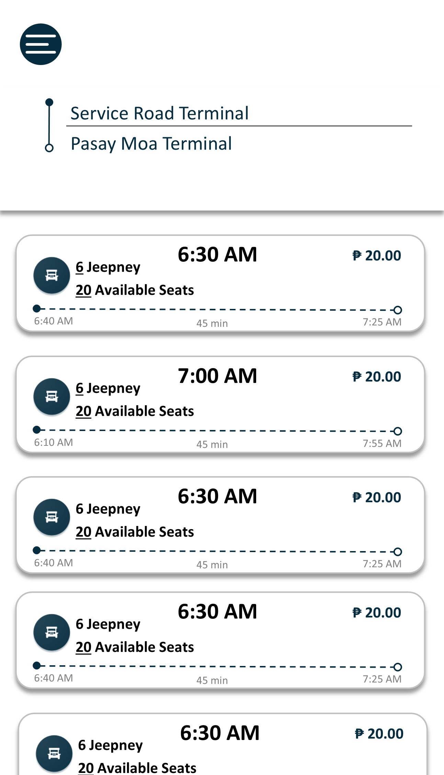
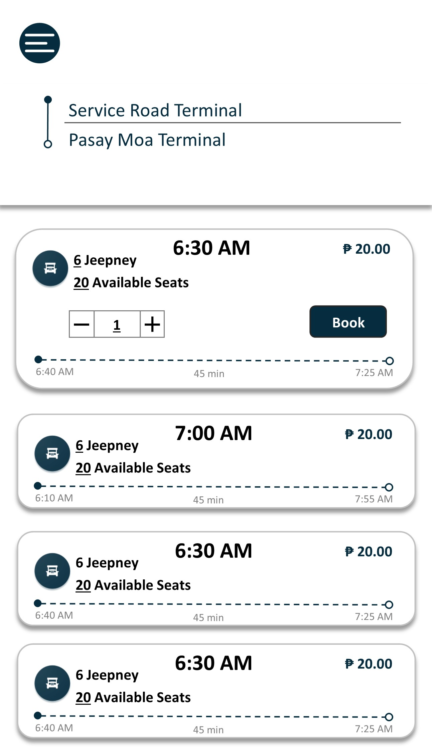
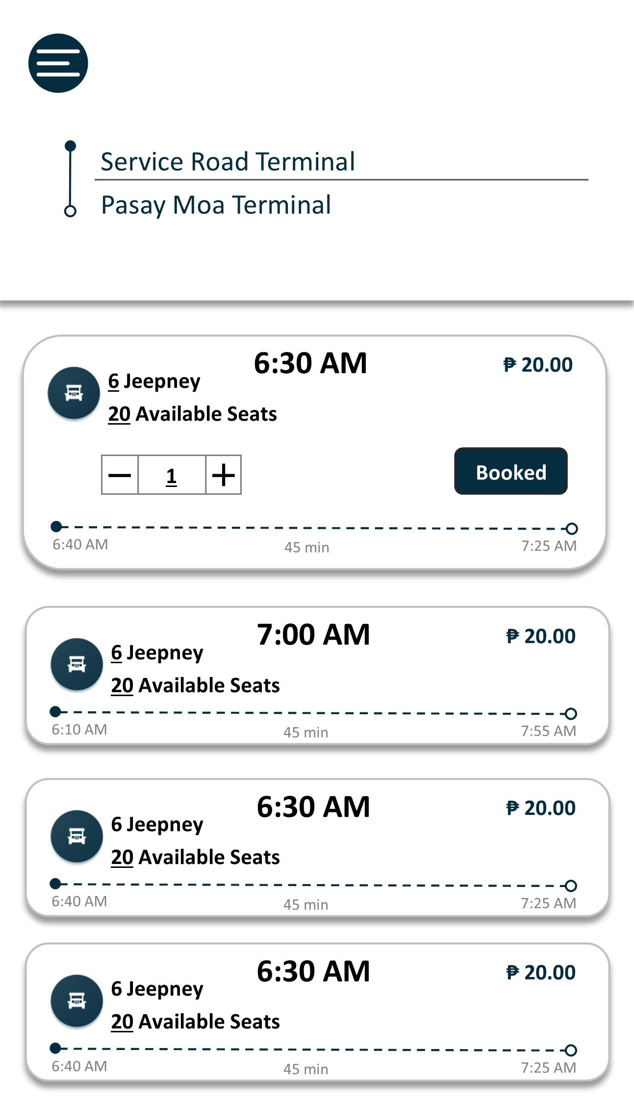
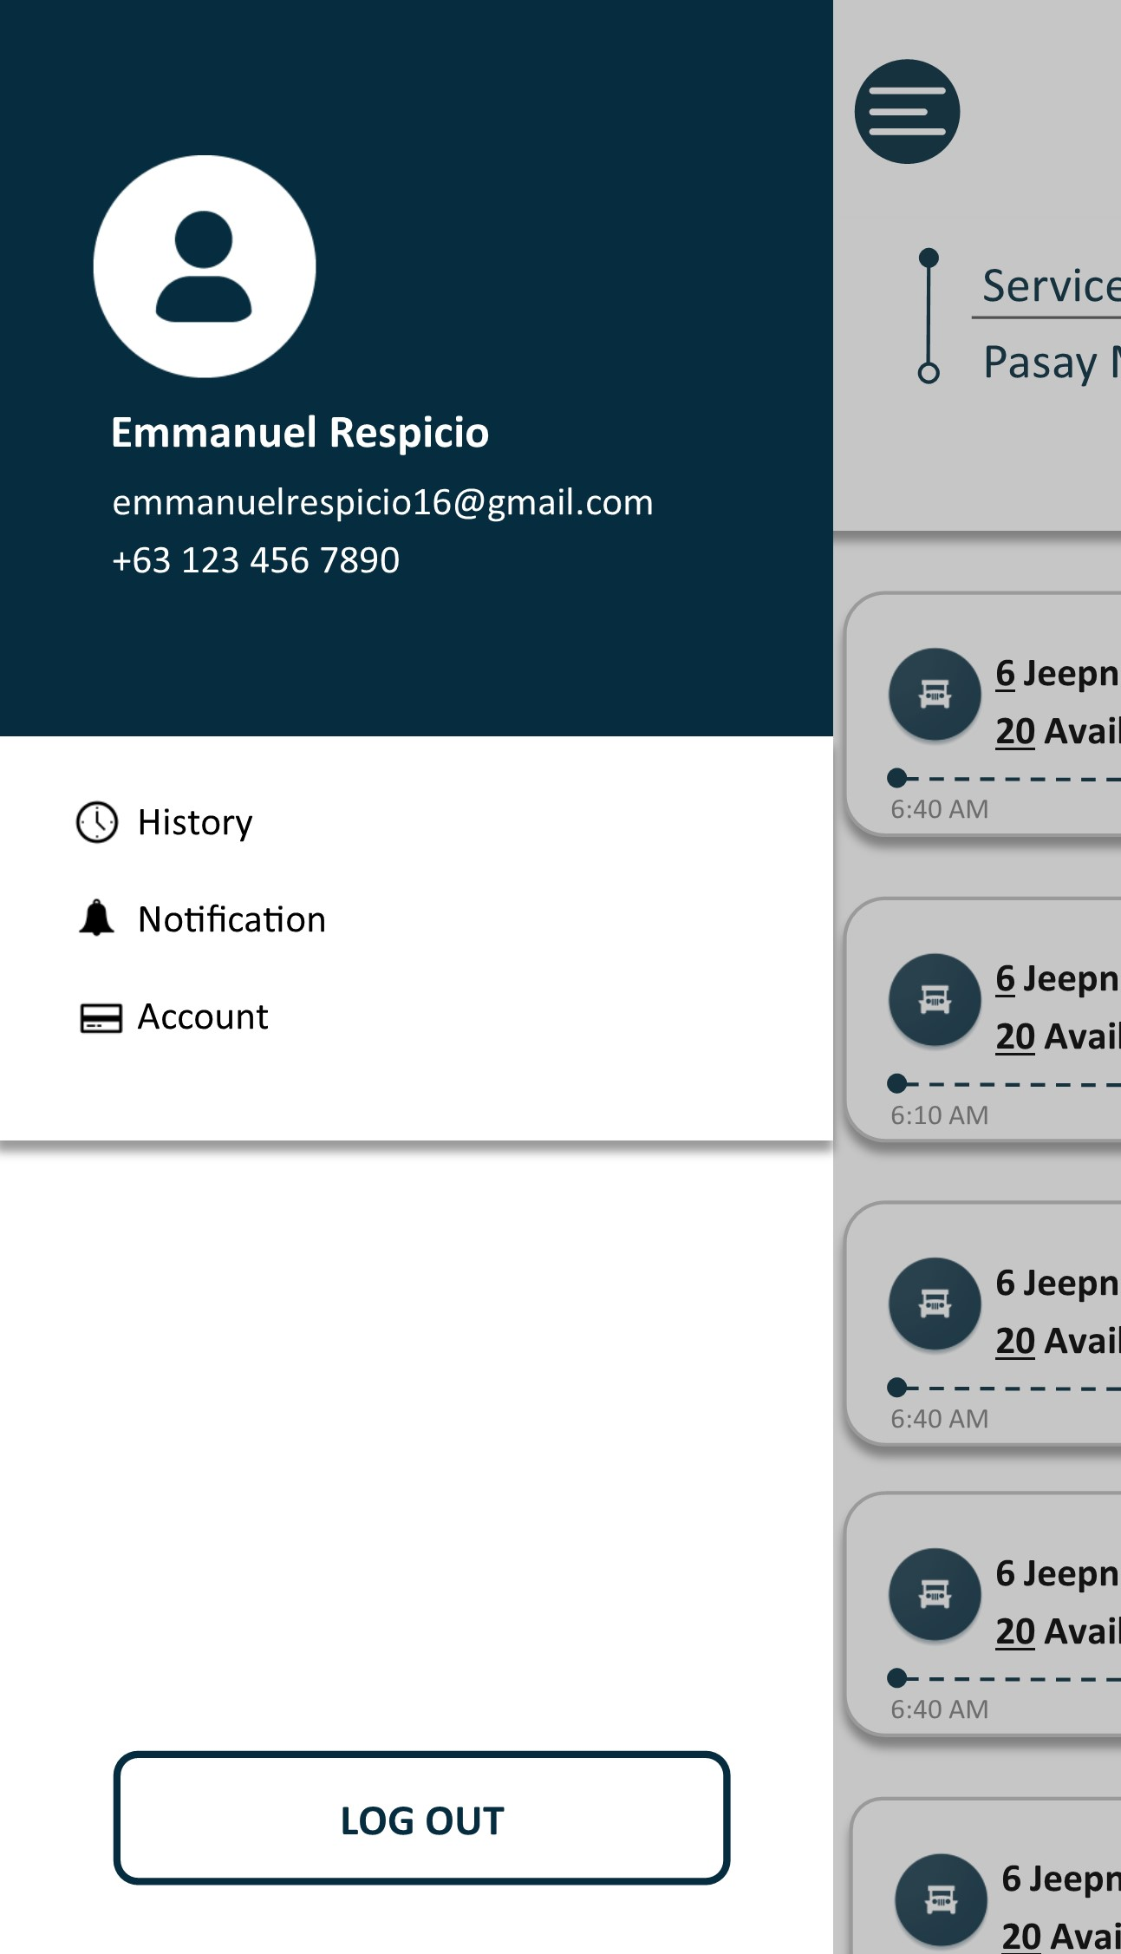
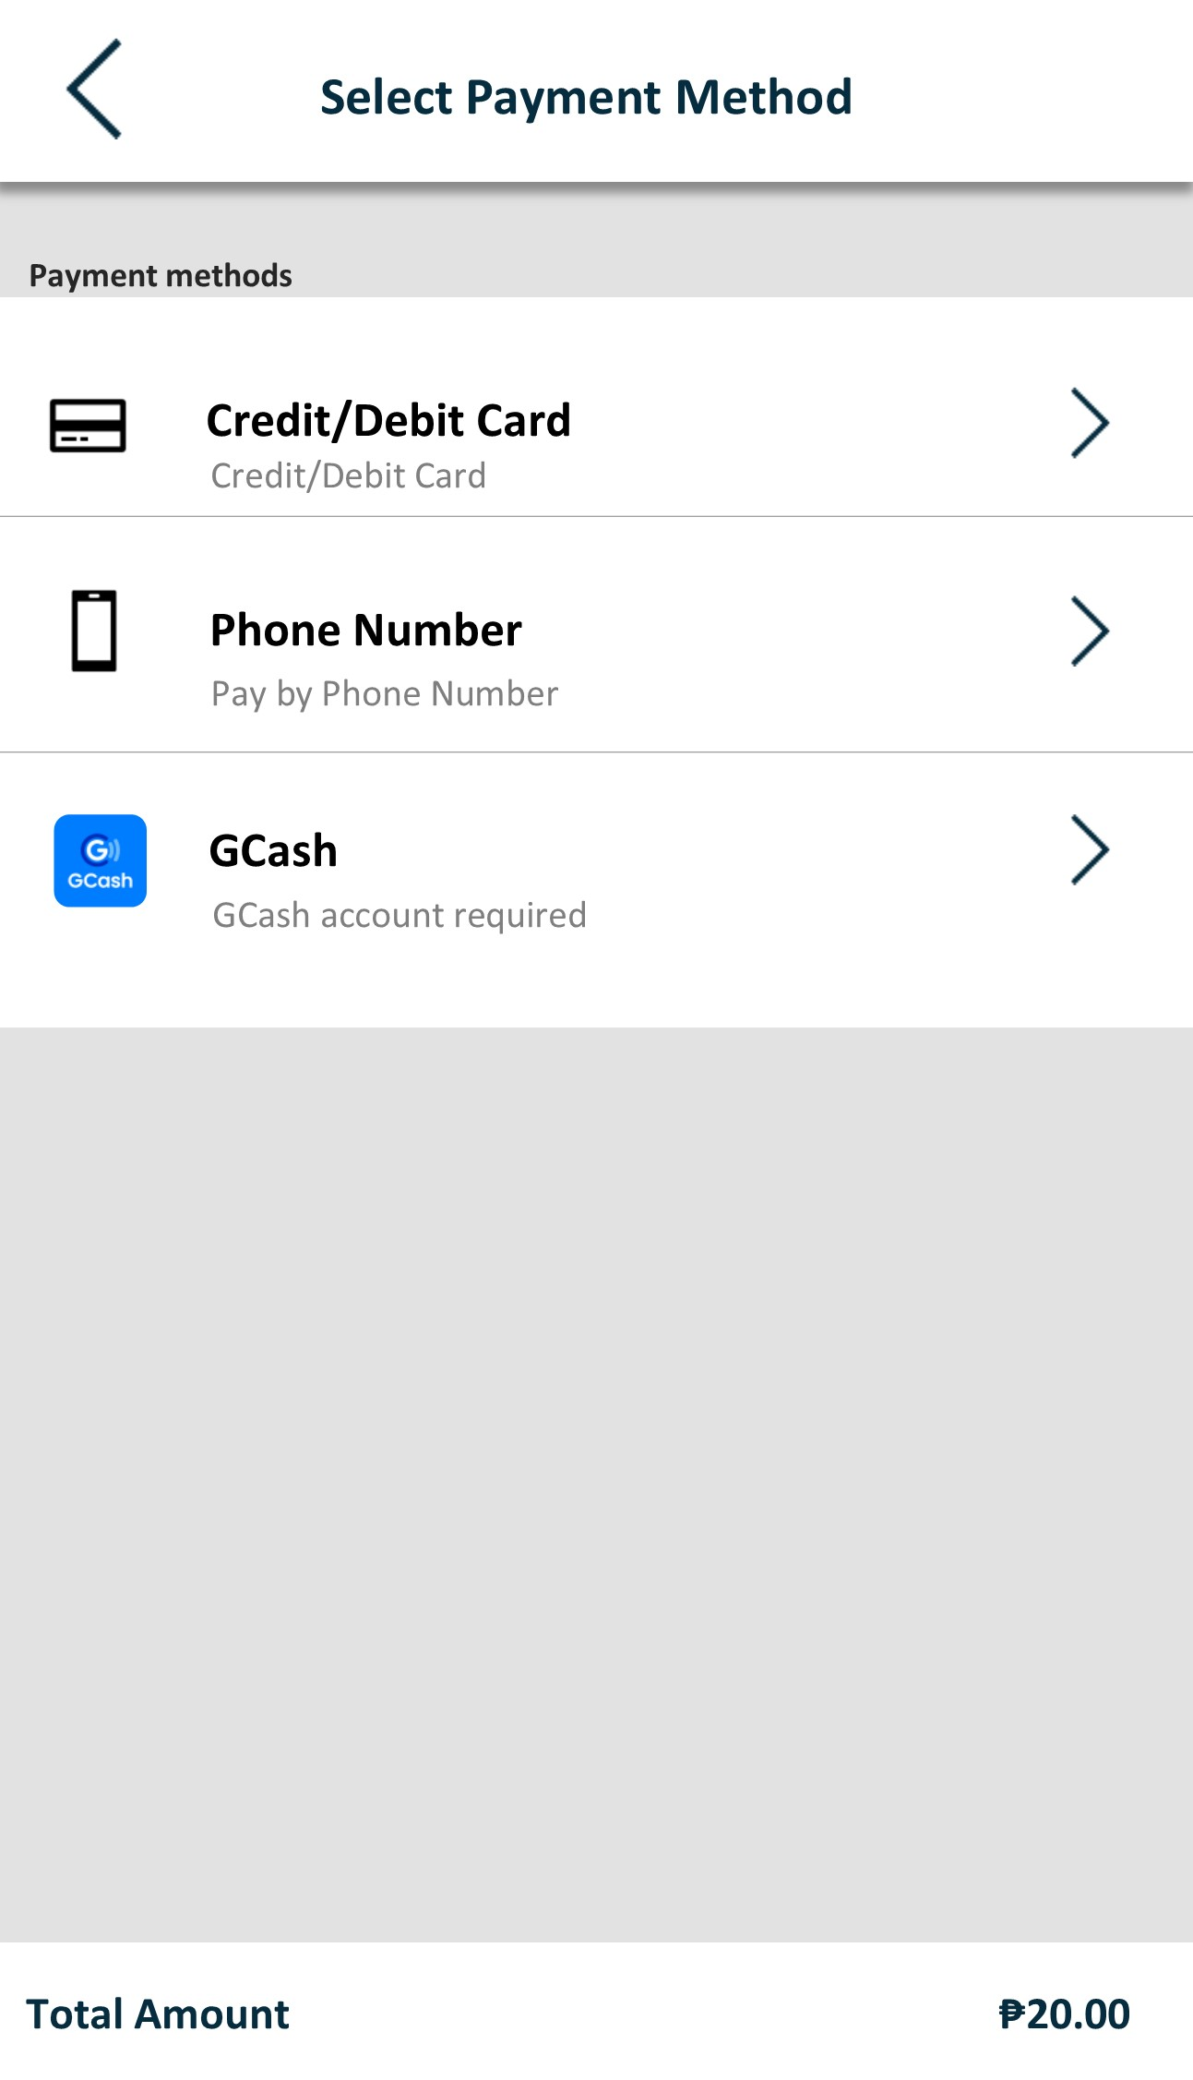
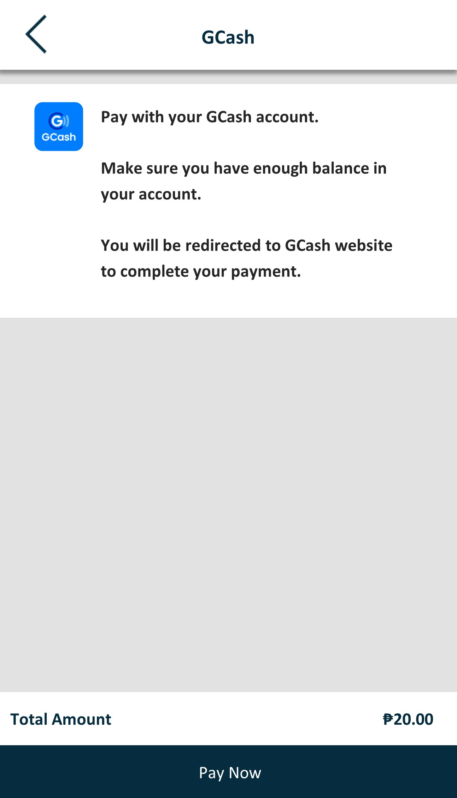
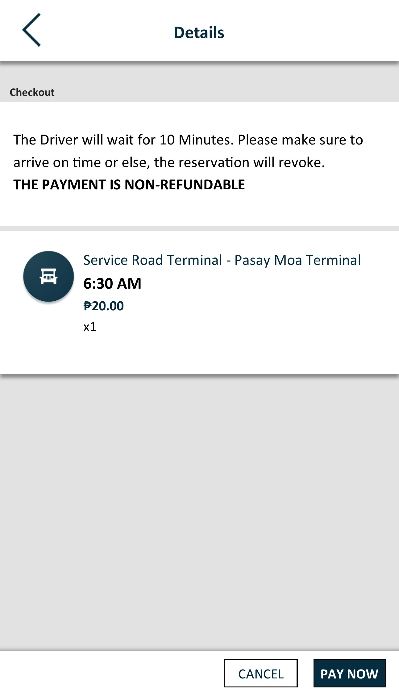
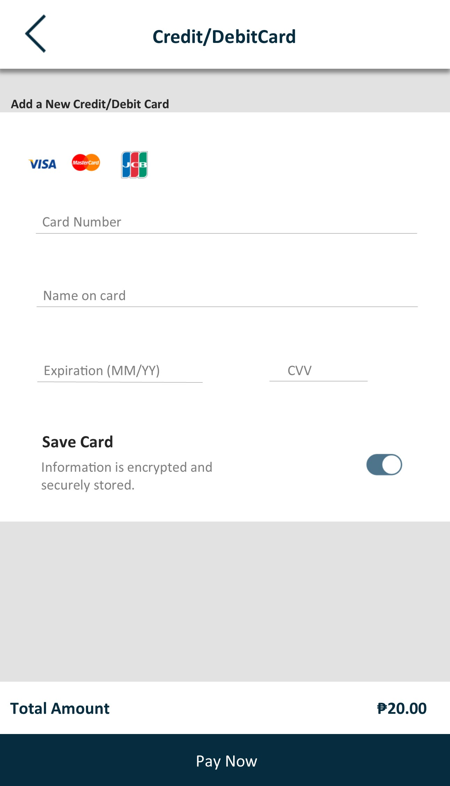
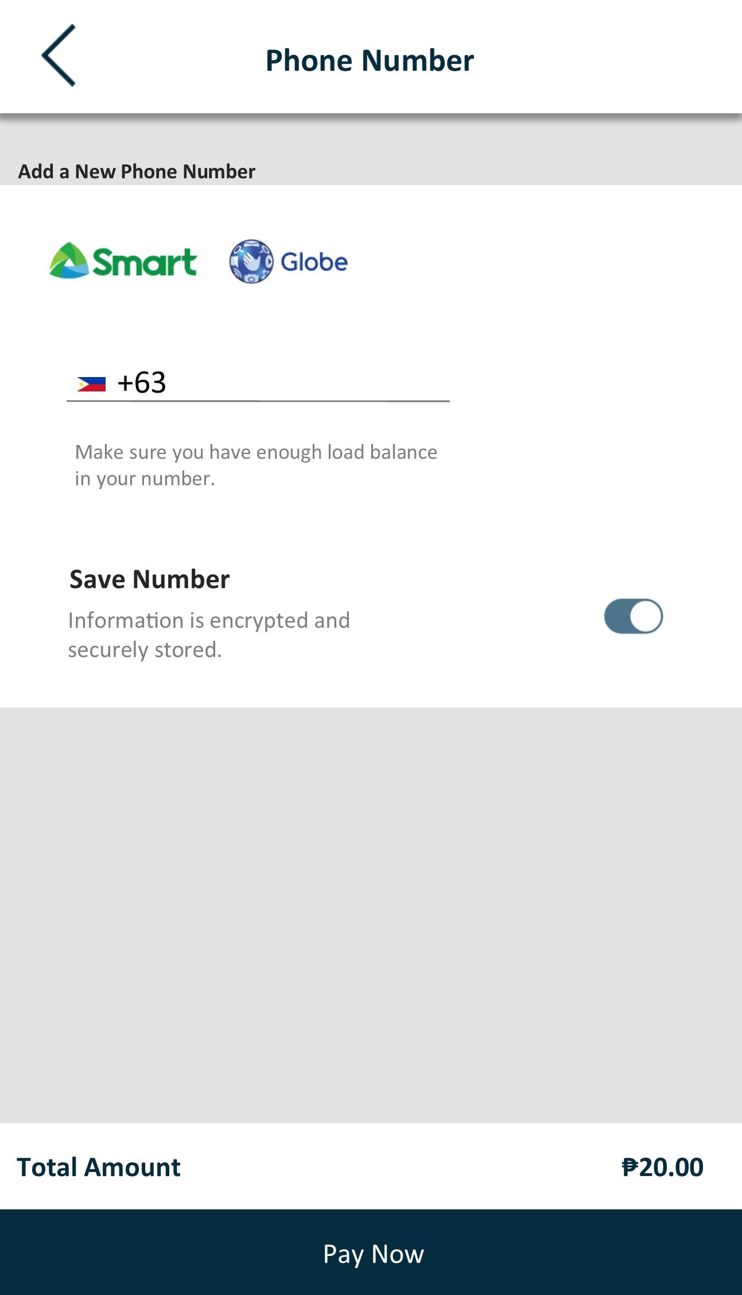

Slide 20
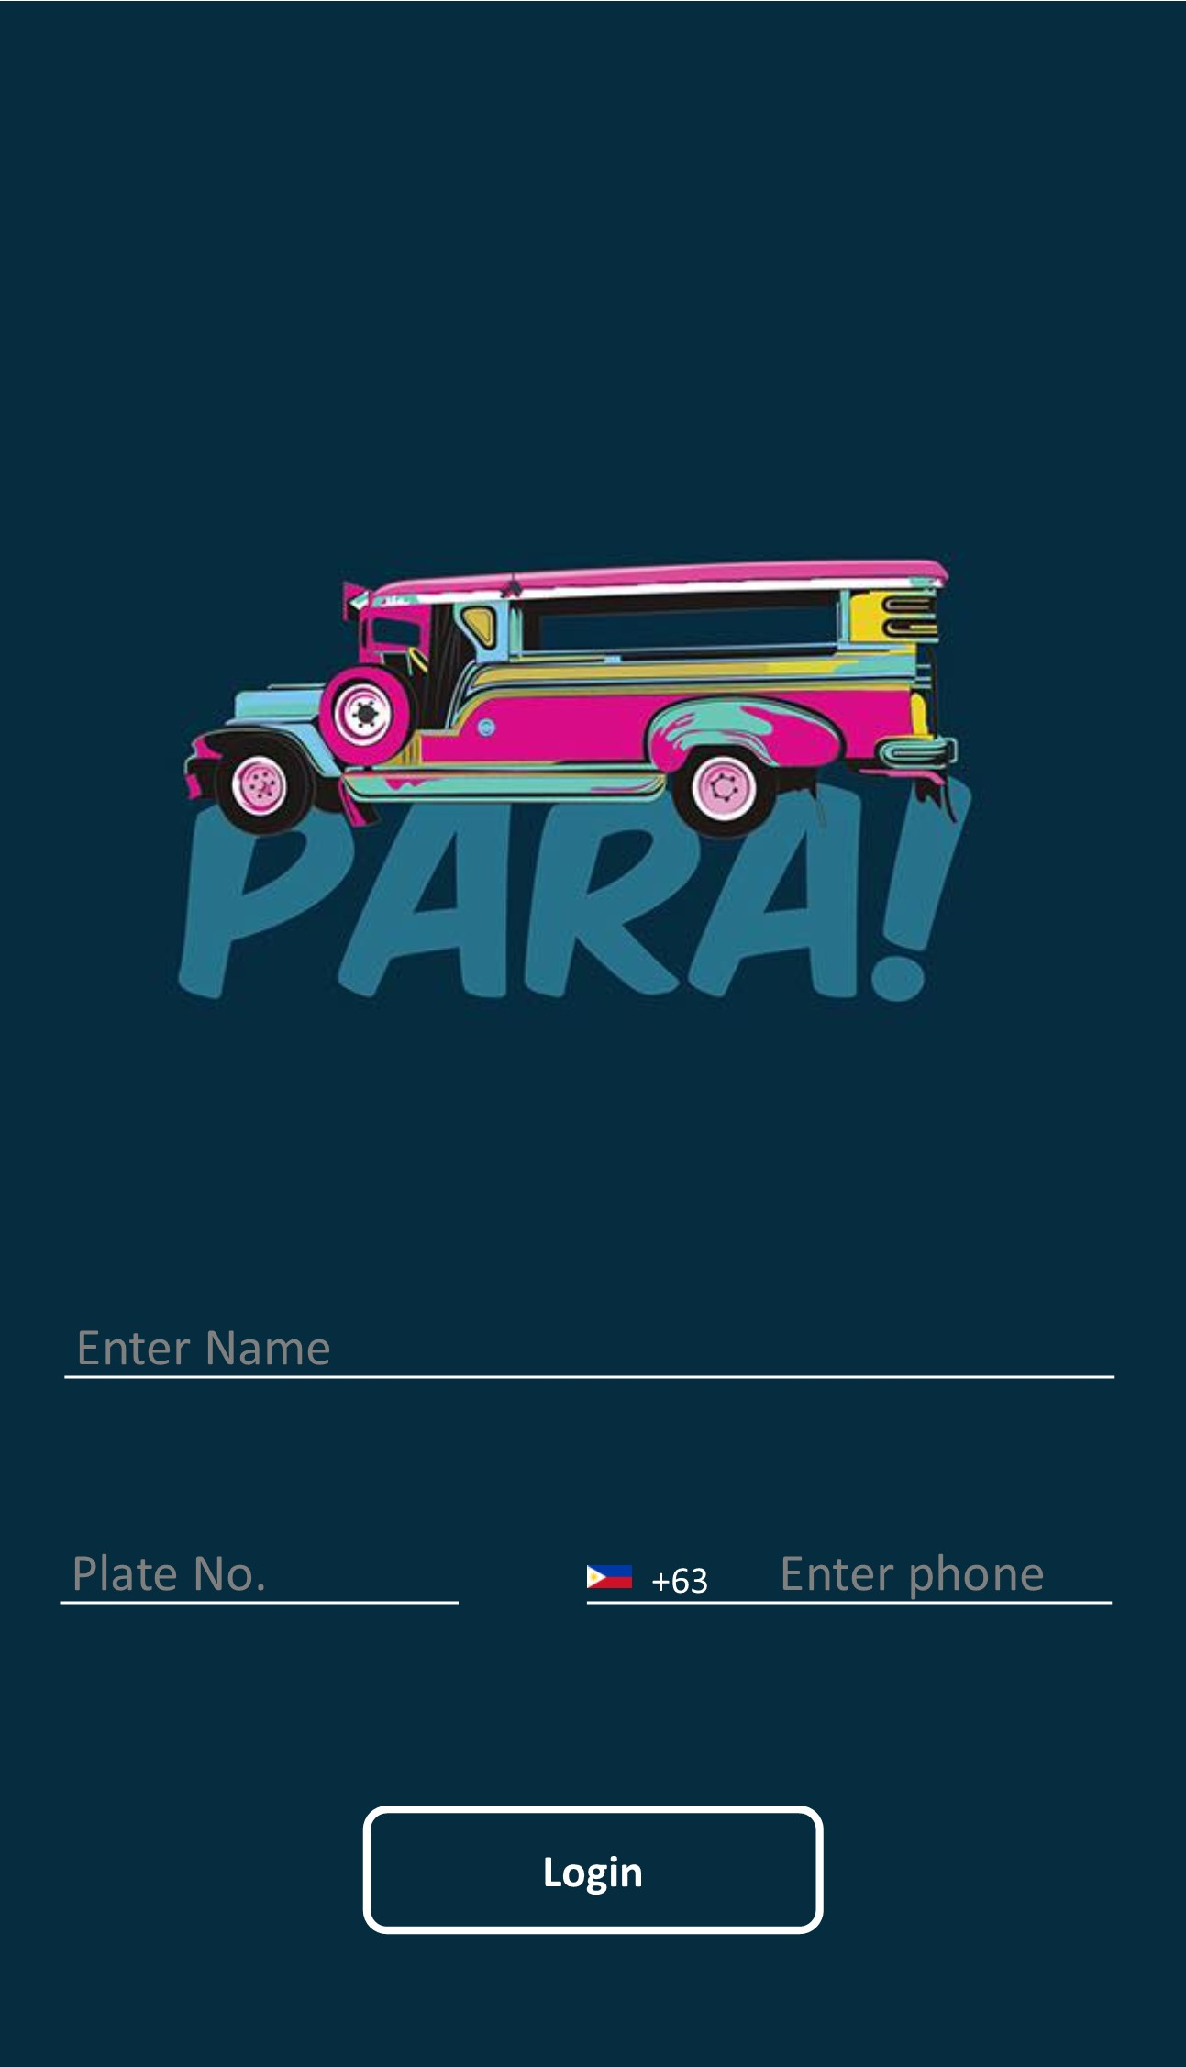
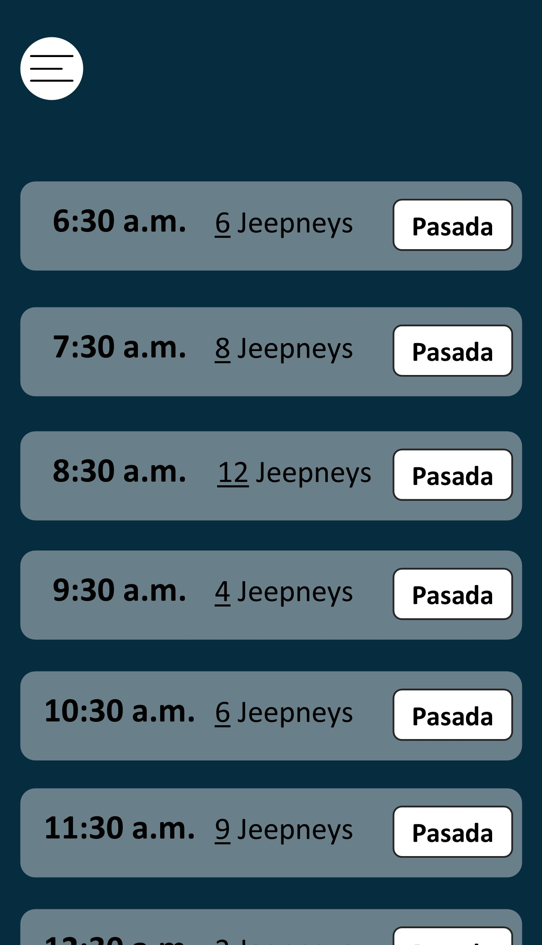
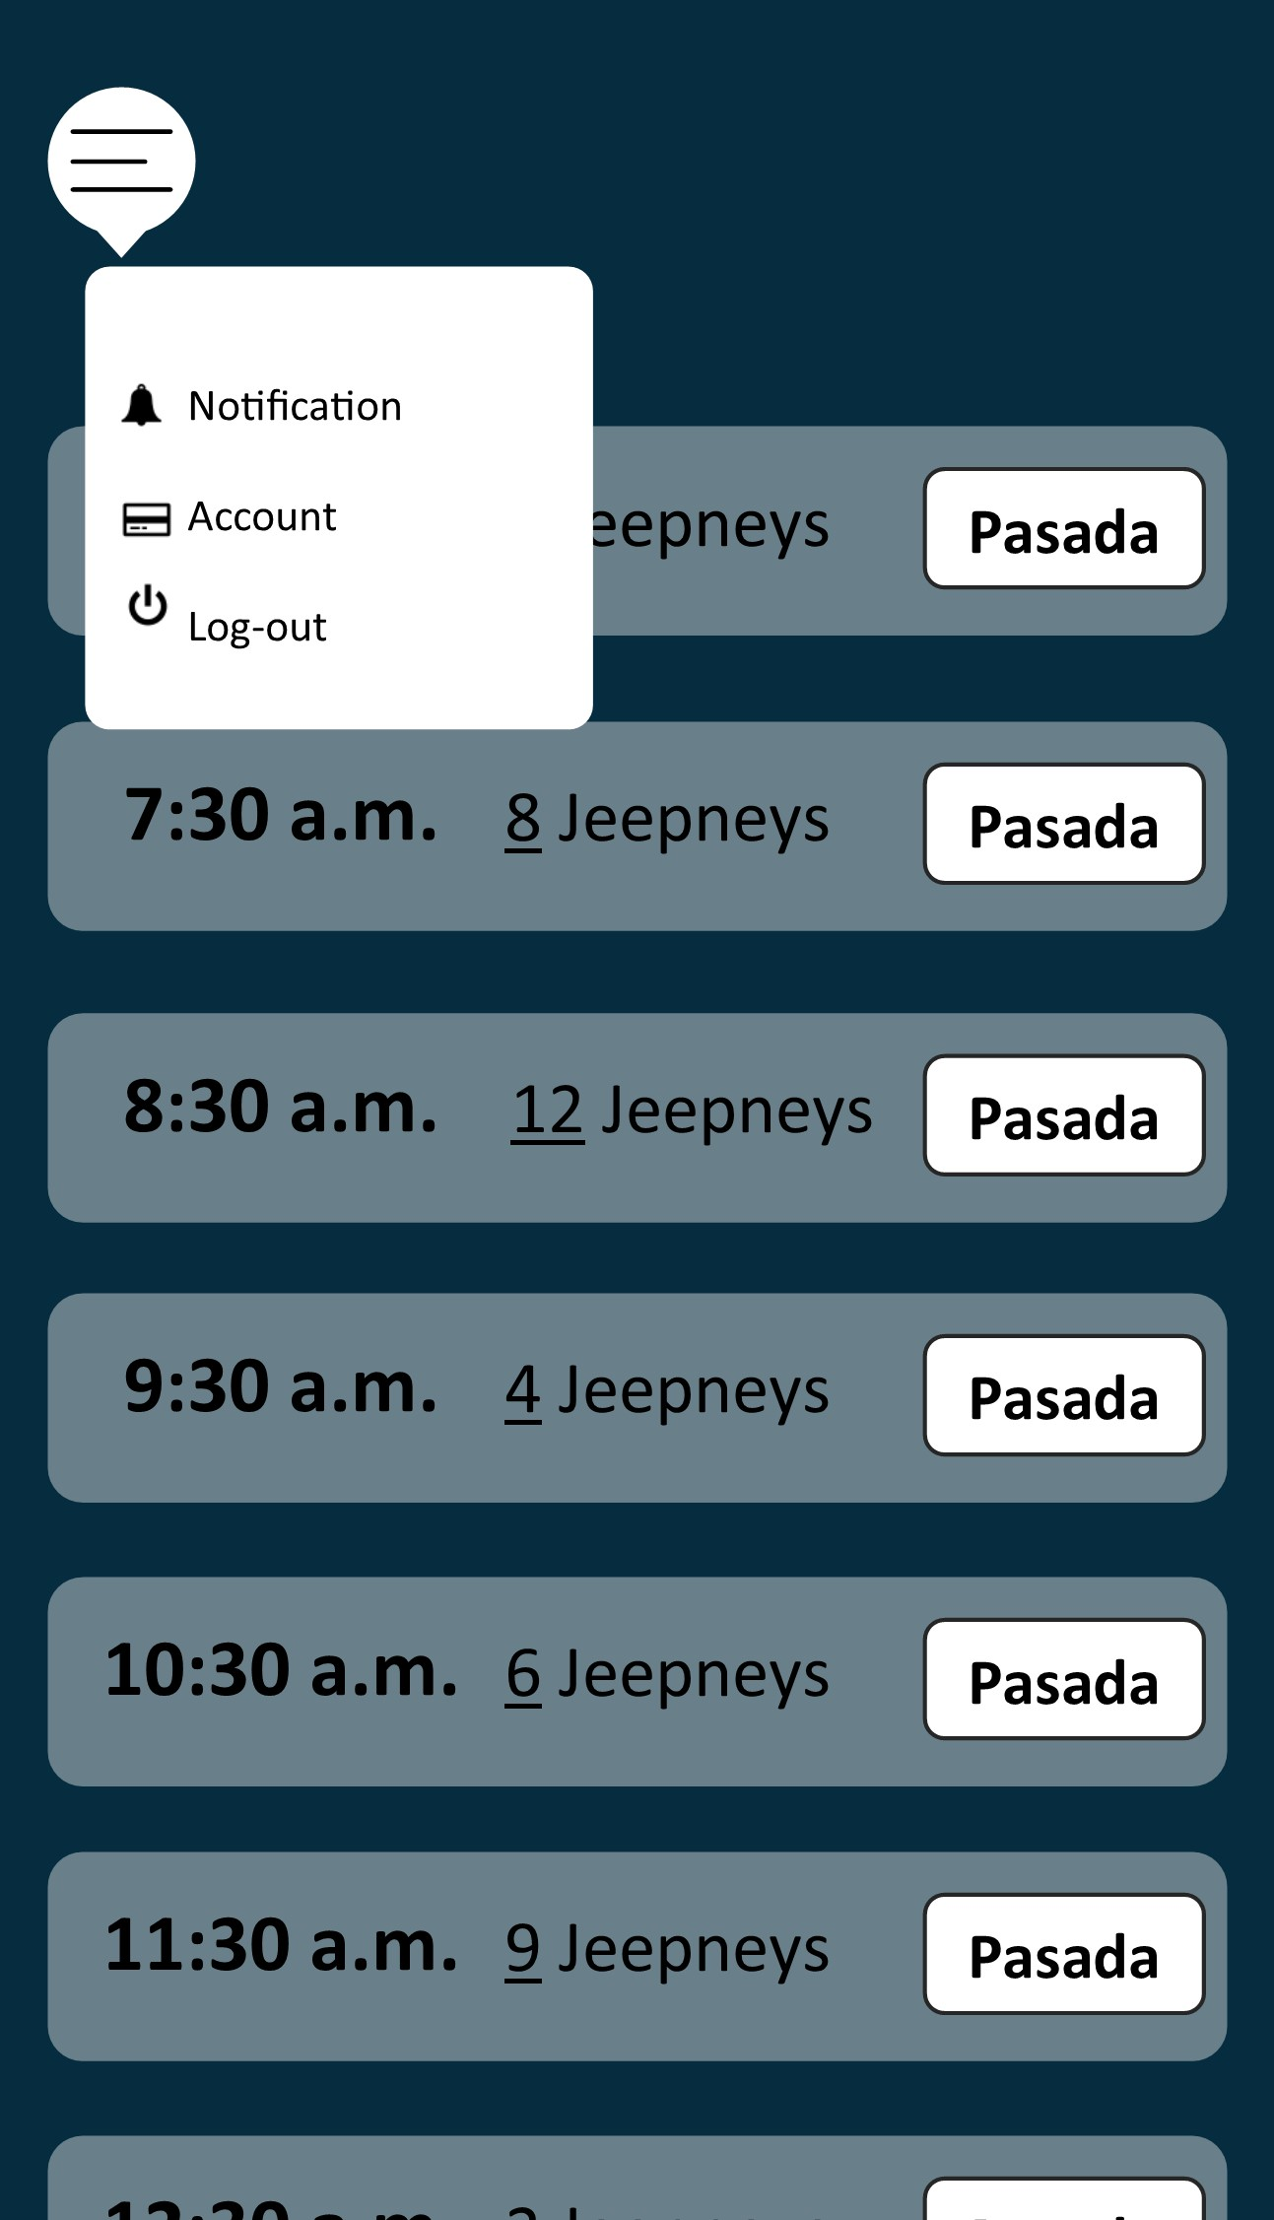
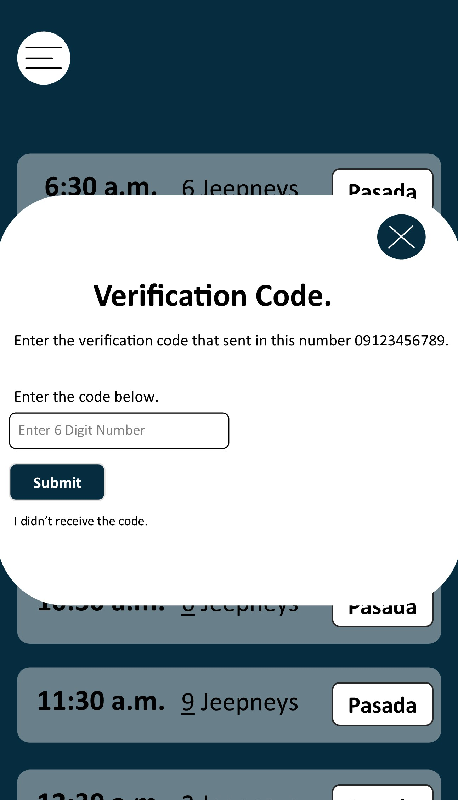

Slide 21
OUR PROCESS IS EASY
Book
Pay
Ride

